Slide 1



Group : 2
Problem Based Learning
Aditya Silver Oak Institute of technology
Department of Information Technology

Slide 2

Smart City :
Smart Street Light
Patel Khushali P.

Slide 3

INTRODUCTION
It has been a while since artificial light has allowed us to see in the dark. We can now light the homes we live in, our workspace and, of course, the streets we wander. This invention has made our lives easier and, as public lighting has become a norm in most parts of the world, safer. Street lighting is now a core piece of urban and rural infrastructure, creating a safe environment for pedestrians and drivers alike.

Slide 4
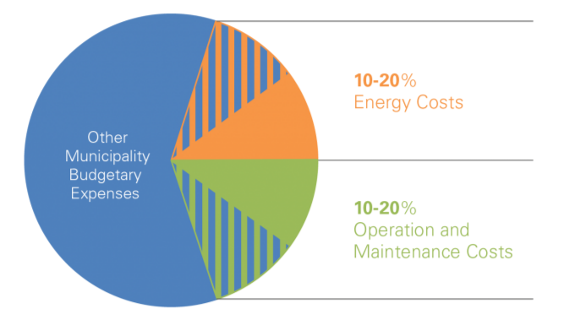
Costing for municipalities
At local and municipal level, public authorities are in charge of providing street lighting as a key public service for citizens’ safety.
This, however, represents a major cost for the local government which can be challenging to accommodate and sustain.
Moreover, it is still common for municipalities to use outdated and inefficient street lighting facilities which leads to a higher energy consumption and increased maintenance costs.
An obsolete lighting system can account for as much as 50% of a typical city’s entire energy bill.
Total Street Lighting Costs in the municipality’s Expenses
(depending on the size of the city and how old are the lighting fixtures)

Slide 5
Environmental concerns
The issue of large energy consumption is a concern not only at a local level, but also globally. Public lighting has been named ‘the nervous system of a city’, connecting hundreds of millions of streetlights with access to power across the globe.
1
2
This constantly increasing number has made lighting responsible for a staggering 19% of global electricity usage and is contributing towards the already exceeding levels of CO2 emissions.
3
Given that, according to the UN, 68% of the total world population will live in urban areas by 2050, it seems more imperative than ever to protect cities’ limited resources.
4
Municipalities face the challenge of creating a secure environment for its current and future inhabitants, while being energy and cost efficient..

Slide 6

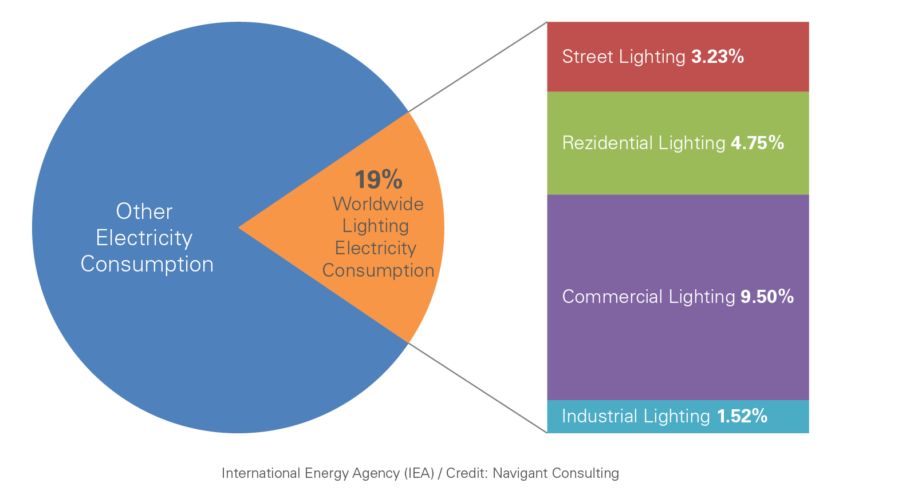
World Electricity Consumption (2018)

Slide 7

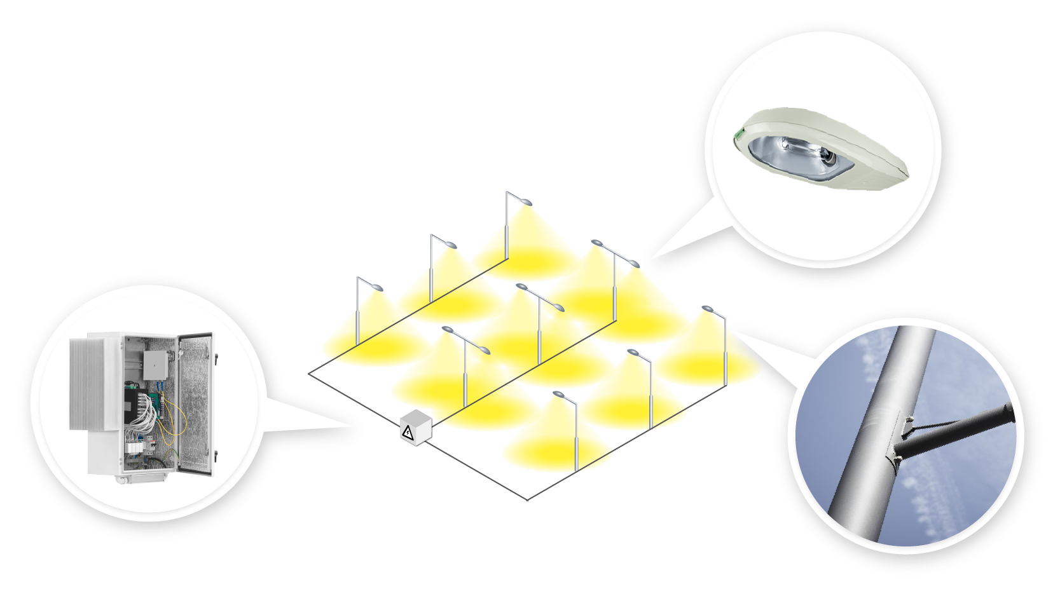
Smart Street Light Infrastructure

Slide 8



The main elements of a street lighting system
Lamps
Street Light pole
Power Cabinet (feeder pillar)
Lumiaire
Light bulbs
Lamp driver (ballast)
With 1,2,3 or more lamps
Sensors
Contactors

Slide 9

Working
When there is a need of light it automatically switches ON. When darkness rises to a certain level then sensor circuit gets activated and switches ON and when there is other source of light i.e. daytime, the street light gets OFF. The sensitiveness of the street light can also be adjusted.
1
2
In our project we have used four L.E.D as a symbol of street lamp, but for high power switching one can connect Relay (electromagnetic switch) at the output of pin 3 of I.C 555 that will make easy to turn ON/OFF any electrical appliances that are connected through relay.
3
Our project working on LDR Circuit.

Slide 10
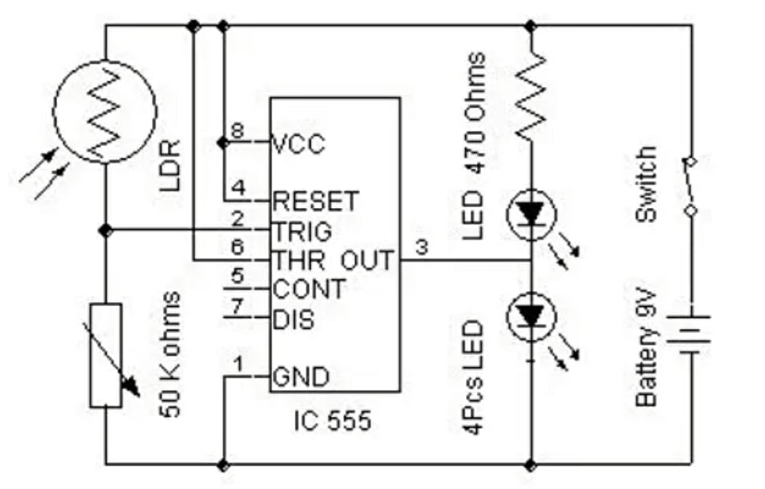
Light Dependent Register
( LDR)
This circuit uses a popular timer I.C 555. I.C 555 is connected as comparator with pin-6 connected with positive rail, the output goes high(1) when the trigger pin 2 is at lower then 1/3rd level of the supply voltage.
Conversely the output goes low (0) when it is above 1/3rd level. So small change in the voltage of pin-2 is enough to change the level of output (pin-3) from 1 to 0 and 0 to 1.
he output has only two states high and low and can not remain in any intermediate stage. It is powered by a 6V battery for portable use.
The circuit is economic in power consumption. Pin 4, 6 and 8 is connected to the positive supply and pin 1 is grounded. To detect the present of an object we have used LDR and a source of light.

Slide 11
LDR is a special type of resistance whose value depends on the brightness of the light which is falling on it. It has resistance of about 1 mega ohm when in total darkness, but a resistance of only about 5k ohms when brightness illuminated. It responds to a large part of light spectrum.
We have made a potential divider circuit with LDR and 100K variable resistance connected in series. We know that voltage is directly proportional to conductance so more voltage we will get from this divider when LDR is getting light and low voltage in darkness. This divided voltage is given to pin 2 of IC 555.
Variable resistance is so adjusted that it crosses potential of 1/3rd in brightness and fall below 1/3rd in darkness.
Sensitiveness can be adjusted by this variable resistance. As soon as LDR gets dark the voltage of pin 2 drops 1/3rd of the supply voltage and pin 3 gets high and LED or buzzer which is connected to the output gets activated.

Slide 12
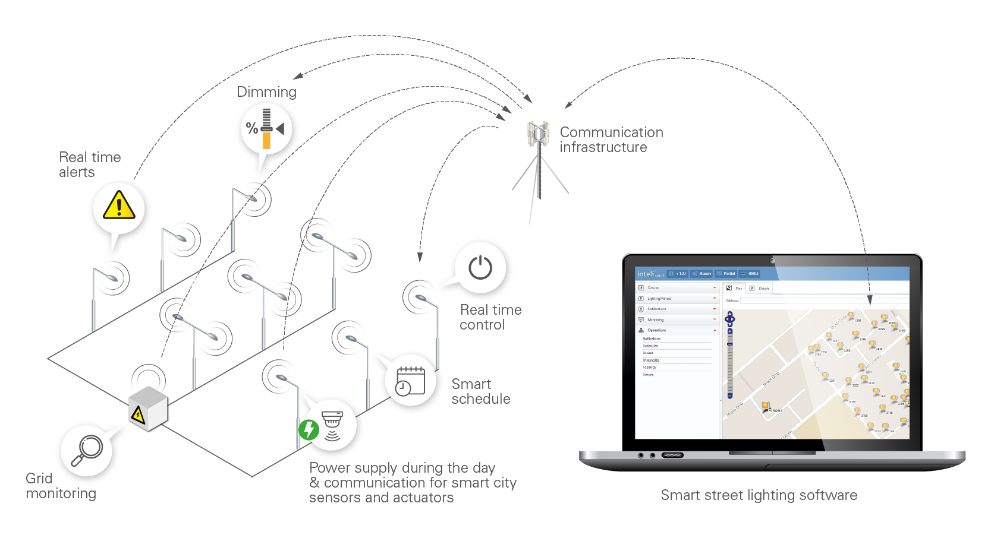
Smart Street Light Control System

Slide 13
How To Work Smart Street Light Control System
The idea of street lighting control appeared long ago, from the struggle of managing large numbers of lamps.
1
2
A solution was needed so that the lamps could be clustered in smaller numbers and handled more efficiently in terms of powering on and off, power outages, maintenance etc.
3
Thus, lighting panel control and monitoring units (power cabinets, feeder pillars) were invented and used to restructure public lighting.
4
This allowed for each light segment to be manually powered on. Later, controllers were installed on these lighting control units
5
They took the place of human intervention, functioning as an automation for switching the light on and off.

Slide 14

6
Since then, street lighting needed to become more effective, less energy consuming, and less polluting. So, control systems have evolved to become ‘smart’ by allowing lamp control and data collection.
7
This was made possible by allowing segment-level and lamp-level control via cabinet or luminaire controllers respectively.

Slide 15

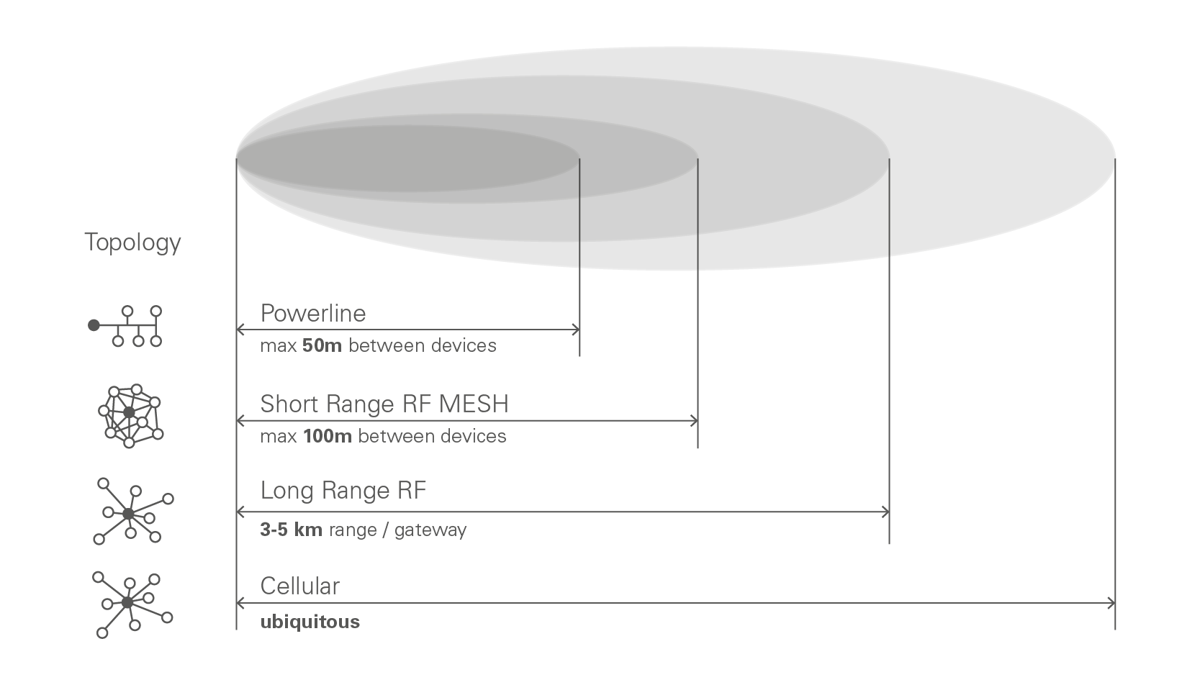
Communication Technology

Slide 16
Powerline Communication
1
Wired or powerline communication (PLC) works on long distances by sending a communication signal directly onto the powerlines.
2
Uninterrupted conductors establish a continuous communication, and the PLC signal doesn’t usually traverse any transformers or power conditioning devices.
3
This is a powerful power-line communication technology for advanced streetlight systems.
When it comes to street lighting, it is generally the case that groups of streetlights share a common powerline.
4
5
These street lights can either communicate with each other or communicate with gateways leading to supervisory control systems.

Slide 17

6
Gateways are tools which synchronise the communication between up to 200 lighting controllers and the lighting control software.
Through wireless connection, an IoT gateway receives, filters and transitions the messages received from the controllers further to the management platform, where they can be analysed.
7

Slide 18

Thank You

